Slide 1




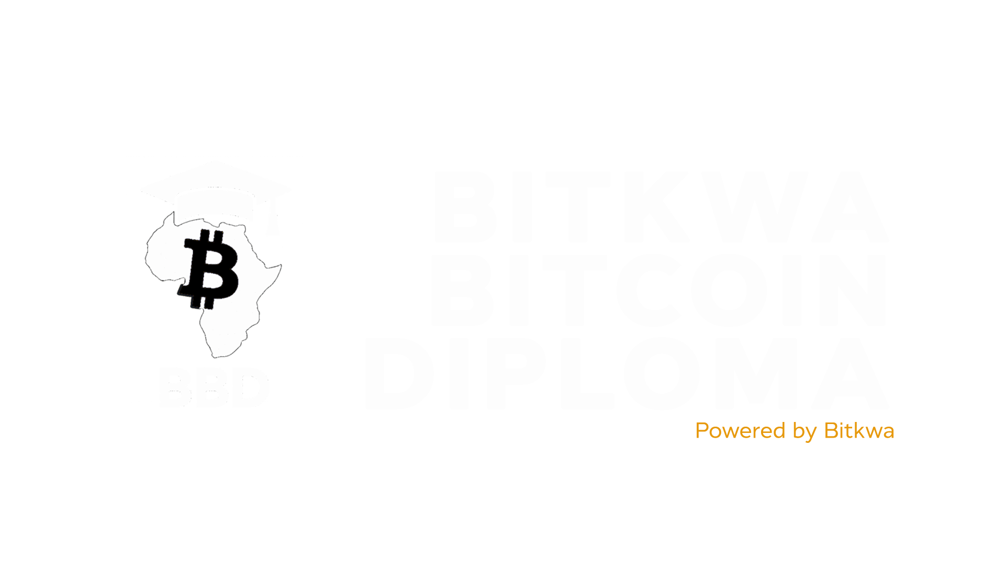


Slide 2
Chapter #7
Careers & Building in Bitcoin
(Africa Focus)

Slide 3




Careers & Building in Bitcoin
Introduction
Bitcoin is not just technology.
For Africa, it is economic agency, ownership, and freedom
Bitcoin create global opportunities
The Bitcoin ecosystem is more than sound money, it’s a growing global movement creating new careers, innovations, and opportunities for builders. Across Africa, Bitcoin is unlocking financial inclusion, inspiring entrepreneurship, and connecting talented individuals to a borderless digital economy.

Slide 4
Careers & Building in Bitcoin
WHY BITCOIN MATTERS IN AFRICA
Banks limit movement of money
Inflation erodes savings
Local currencies lose value overnight
Banks block or limit transactions
Millions are unbanked or excluded
Youth unemployment is high

Slide 5

Careers & Building in Bitcoin
THE BITCOIN ECONOMY IS OPEN
To work in Bitcoin
You don’t need:
A special degree
A visa
Wealth
Permission
You need:
Skills
Consistency
Proof of Work

Slide 6
Careers & Building in Bitcoin
5 Career Pathways in Bitcoin
Path | Example Roles
Technical | Lightning dev, wallet dev, researcher
Product & Operations | PM, strategy, operations lead
Education & Community | Trainer, mentor, meetup organizer, Community Manager
Creative & Media | Storyteller, designer, content creator
Entrepreneurship | Build Bitcoin-first products/services

Slide 7
Careers & Building in Bitcoin
TECHNICAL PATH (BUILDERS OF THE PROTOCOLS)
You will enjoy this if you like:
Start with:
Where to learn:
Solving puzzles
Writing code
Understanding systems deeply
Python, Go, or Rust
GitHub basics
Contributing to open-source
Bitkwa Labs
Btrust Builders
Africa Free Routing Bootcamp
Summer of Bitcoin

Slide 8

Careers & Building in Bitcoin
PRODUCT & OPERATION
If you are organized, strategic, adaptable:
Product Manager
Operations Lead
Program Coordinator
Business Development
Your role:
Turn vision → Execution
Make the work move.

Slide 9

Careers & Building in Bitcoin
EDUCATION & COMMUNITY
Africa needs:
Teachers
Translators
Meetup organizers
Onboarding guides
If you can explain simply, you can lead powerfully

Slide 10

Careers & Building in Bitcoin
CREATIVE & MEDIA
If you can communicate, you can contribute.
Bitcoin needs:
Stories
Culture
Emotion
Opportunities in:
Design
Video
Podcasting
Social media narrative

Slide 11

Careers & Building in Bitcoin
Where to Find Bitcoin Jobs
Key:
Most Bitcoin roles are shared through community, not just job boards.
These platforms post real Bitcoin & Lightning roles:
bitcoinerjobs.com (most active Bitcoin jobs board)
stacker.news/jobs (open-source + startup-friendly)
Nostr / Twitter (many roles shared informally)
Company websites directly (Blink, Breez, Galoy, Voltage, etc.)
Bitcoin Only groups (Whatsapp, Telegram,Discord etc)

Slide 12
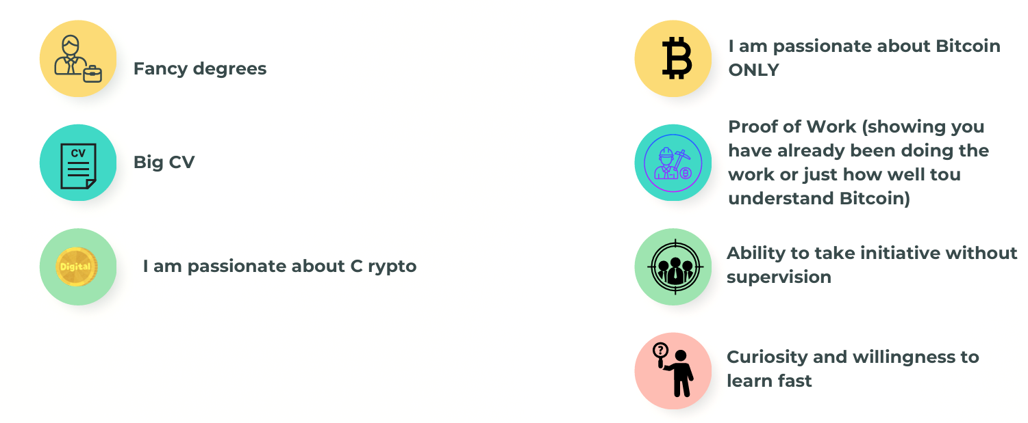
Careers & Building in Bitcoin
WHAT BITCOIN COMPANIES LOOK FOR
NOT
BUT
I am passionate about Bitcoin ONLY
Proof of work
Take initiative without supervision
Curiosity and willingness to learn fast
Fancy degrees
Big CV
I am passionate about C rypto

Slide 13
Careers & Building in Bitcoin
What Proof of Work Looks Like
Role Interest | Your Proof Of Work
Developer | Contribute to an open-source repo, even fixing small issues
Educator | Make a simple Bitcoin explain video/thread in your language
Product/Ops | Run a small Bitcoin onboarding event or process a community survey
Creative | Create shareable graphics, videos, or animations explaining Bitcoin
Entrepreneur | Onboard 1 merchant + show Lightning payments working
You don’t say you can do the work. You show it.

Slide 14
Careers & Building in Bitcoin
THE TRUTH ABOUT THE BITCOIN JOB MARKET IN AFRICA
1.
Many projects are one or two people trying to do everything
2.
Many projects are one or two people trying to do everything.
3.
Teams are small, budgets are lean, and roles are not always formal
4.
Bitcoin in Africa is still early, we are building the foundation, not hiring at scale yet
So the most realistic path today is:

Slide 15

Careers & Building in Bitcoin
Realistic Path To Contribute to Bitcoin In Africa
If you are organized, strategic, adaptable:
Entrepreneurship
Collaboration
Contribution
Your best opportunity is to use your skills to solve real problems in the Bitcoin space:
Teach
Build tools
Onboard merchants
Create education & content
Support communities
Contribute to open-source
The people who start building now become the leaders of this ecosystem later.

Slide 16
Careers & Building in Bitcoin
If you don't try you will never know. Choose what path you are passionate about and give it your best!

Slide 17

Careers & Building in Bitcoin
YOUR CAREER BUILDER ASSIGNMENT
Pick your preferred career path
Identify 1 company you'd want to work with
Create 1 Proof of Work that aligns with that company
Share it publicly (X, LinkedIn, Nostr, Telegram group)
This is how people find you

Slide 18



Q&A

Slide 19
THANK YOU

